Slide 1
E-Consulting services
Group 1
TEAM MEMBERS​
JOSHI, SAAJAN NARAYAN (C0871662)​
NIRAULA, VIJAYA (C0877806)​
SHAH, SUBODH (C0879812)​
REDDY, AMBHARAPU AJAY KUMAR (C0865533)​
SHRESTHA, KARAN (C0855971)​
​

Slide 2
Project Charter
1
Major Milestones
Project description
Dec 2022
Feb 2023
Design
Project Name
Research and Discovery
E-Consulting services
Project manager
Jul 2023
Development
Katherine Langford
Project Teams
Ajay Reddy
Karan Shrestha
Saajan Joshi
Vijaya Niraula
Subodh Shah
Jul 2023
Environment Setup and Testing
Aug 2023
Completion

Slide 3
Project Charter
2
Problem statement
Project Requirements
Project Scope
In the last two years, we are facing difficulties in providing consulting services due to geographical barriers and COVID
Customer Service virtually
Schedule view
Timely service
Video conference and communication
Quick response
HR management
Cost management
Risk management
Timely Delivery
Create WBS
Validate Scope

Slide 4
Stakeholders Register
3
Stakeholder name | Role in the company | Role in the project | Level of Impact | Level of Interest
Katherine Lanford | Project Manager | Project Manager | High | High
Taylor Swift | Consultant | Lead Designer | High | High
Mike Sundby | VP of HR | Project Champion | High | High
Lucy Camerena | Training Director | Project Sponsor | Medium | High
Bill Monroe | Director of Accounting | Functional Manager | Low | Low
John Jenkins | Project Manager | Internal Project Manager | Low | High
Jim House | Marketing Administrator | Marketing | High | High
$9,640

Slide 5
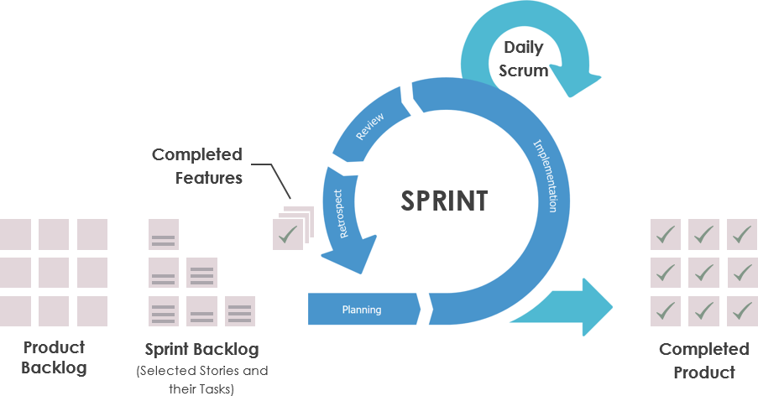
Agile Methodology
4
Project is done in 2 weeks sprint cycle.
$9,640

Slide 6
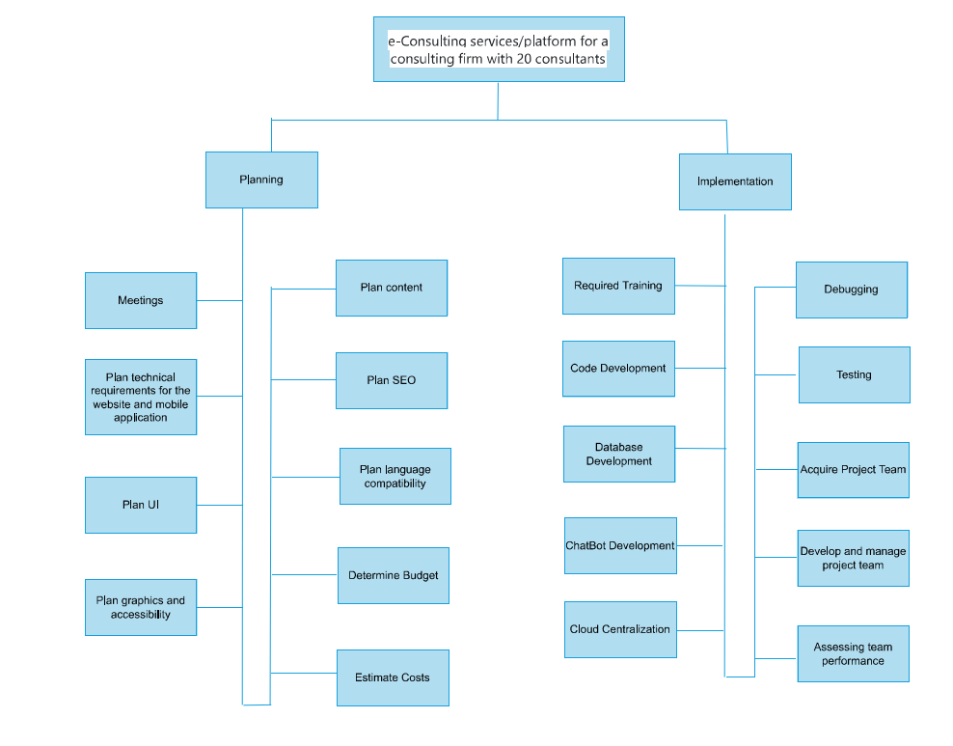
WBS
5
$9,640

Slide 7
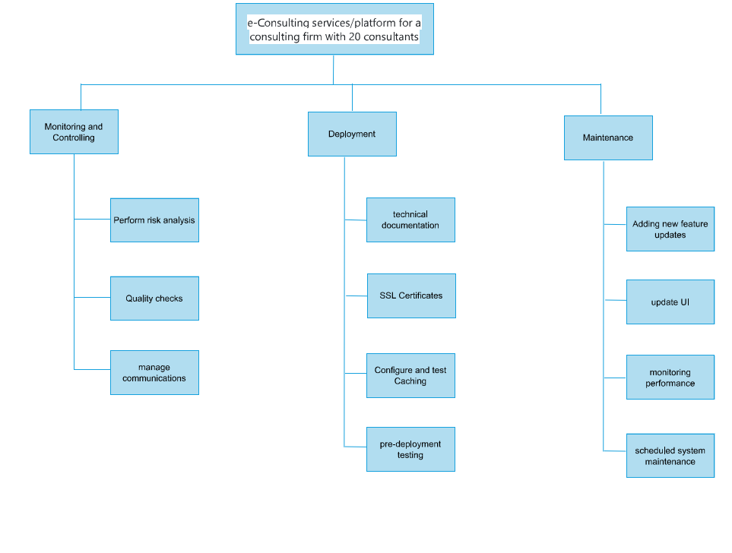
WBS Continued..
7
$9,640

Slide 8
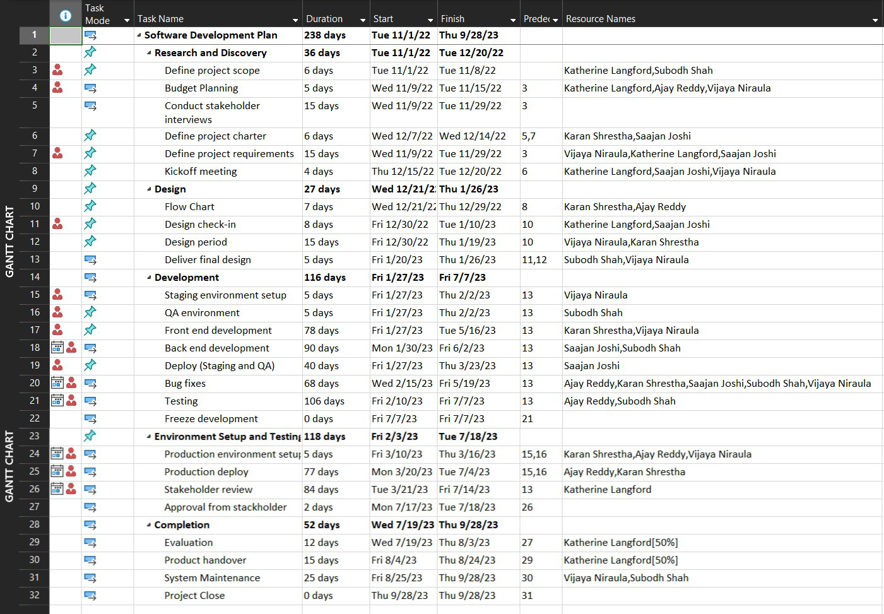
Task Sheet
8

Slide 9
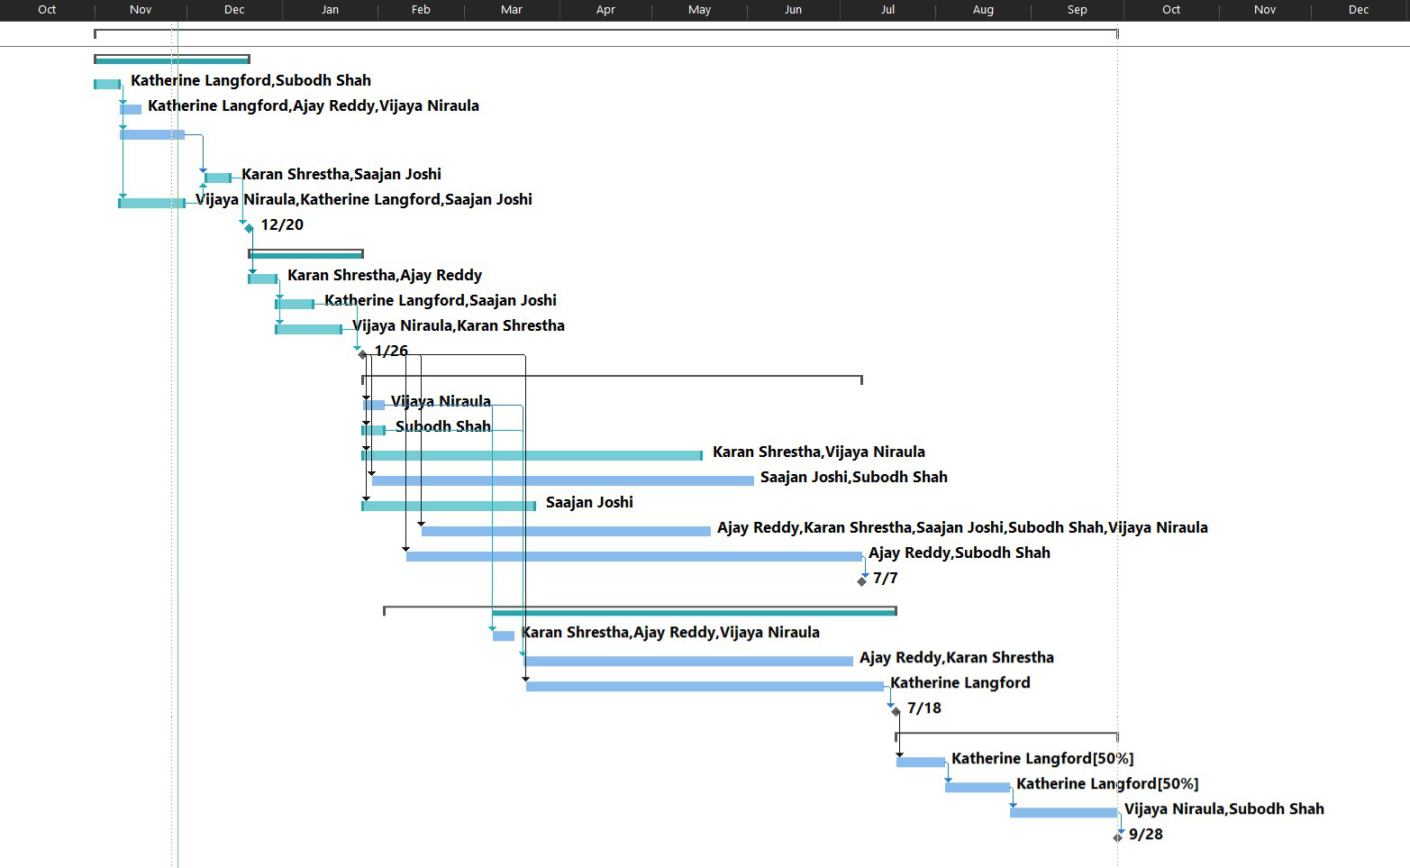
Gantt Chart
9

Slide 10
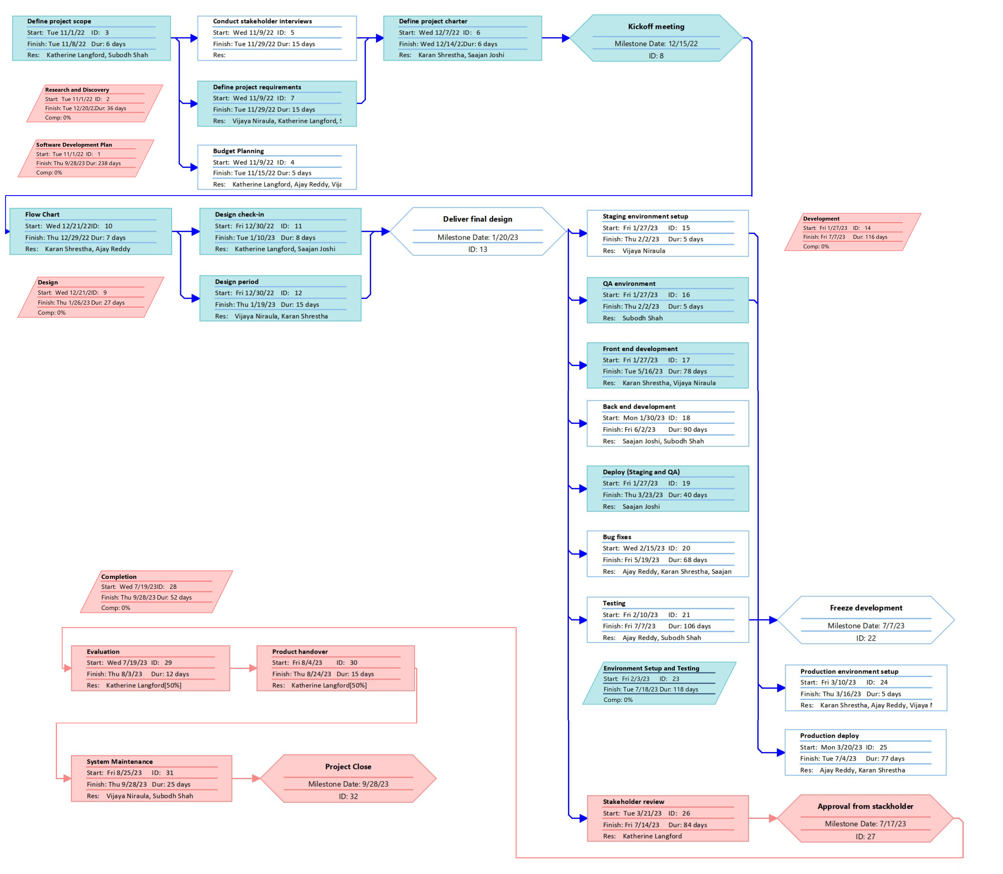
10
NETWORK DIAGRAM
$9,640

Slide 11
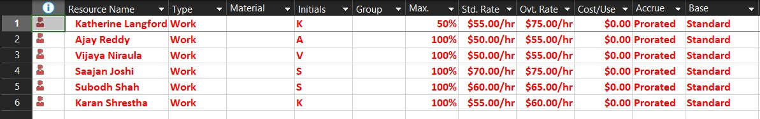
Project Resource
11
$9,640

Slide 12
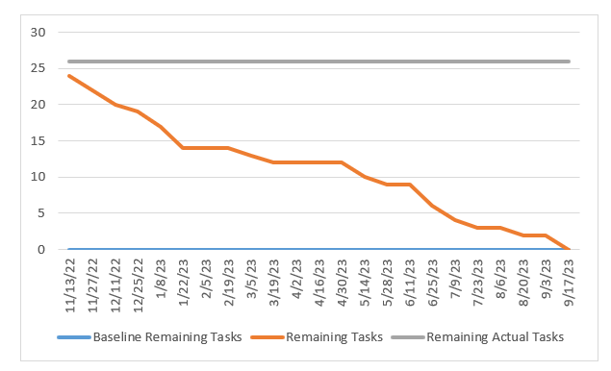
Burndown Chart
12

Slide 13
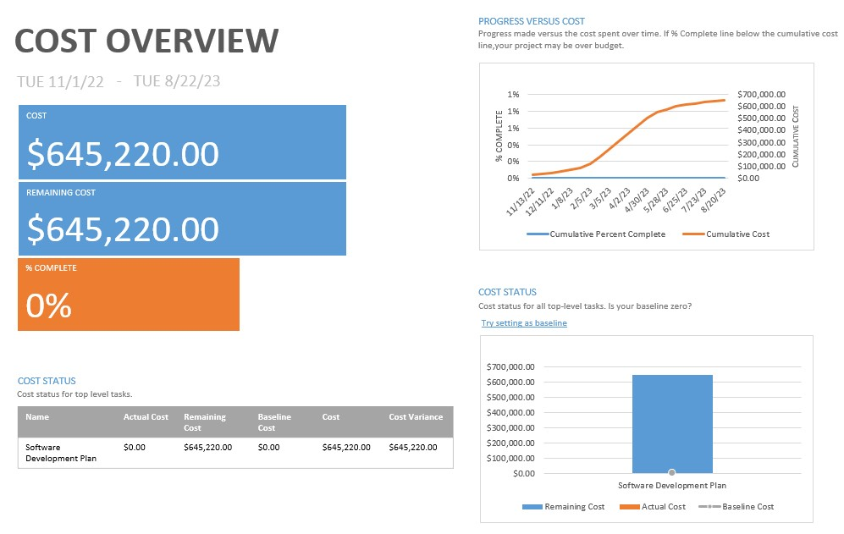
Project Budget
13

Slide 14
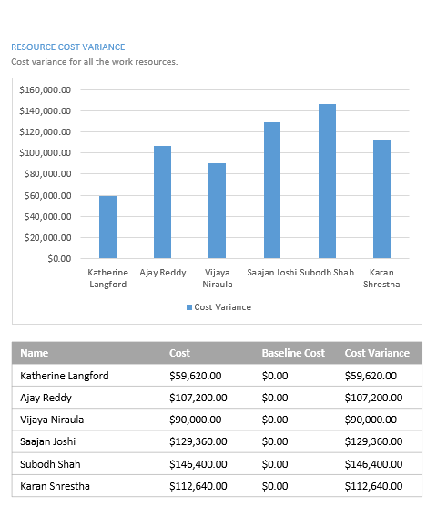
Project Budget (Continued)
1

Slide 15
Risk Analysis
14
Risk Event | Probability | Impact | Mitigating Action
Cost risk | High | High | Proper management and planning with accurate cost estimation.
Scope creep | Medium | High | Establish good communication between stakeholders.
Low performance | Medium | Medium | Follow proper plans, goals and bug fixes.
Schedule Risk | Low | High | Proper management and utilization of resources.
Operational changes | Low | Medium | Making no changes during the project and making sure no employee leaves before the delivery.
$9,640

Slide 16
Lessons Learned
15
Worked Well
Needs Improvements
Realistic identification of risks an management of risks
The project actual budget exceeded the planned figure
Release were deployed in timely manner
Project delivered on time
Meeting : length , frequency
Proper use of MS Project and analyze the workload on the team
Changes in scope and requirement
Frequent training should have been done

Slide 17
References
16
https://www.projectmanager.com/blog/risk-management-process-steps
https://www.wrike.com/project-management-guide/faq/what-is-scrum-in-project-management/
https://support.microsoft.com/en-us/office/basic-tasks-in-project-8fdbf020-a9e1-45e4-bf15-23a8d2b6797d
https://www.workbreakdownstructure.com/
https://www.gantt.com/

Slide 18


